Slide 1
Blue Shield Medicare PPO Transition Update
Health Service Board Meeting • November 14, 2024
Presenters:
Rey Guillen, SFHSS Chief Operating Officer
Olga Stavinskaya-Velasquez, SFHSS Operations Manager
Rob Smith, Senior Director - Medicare Growth
Tiffany Gill, Strategic Account Executive

Slide 2
Agenda
SFHSS Update | Blue Shield Update
Project | BSC Implementation Dashboard
Objective | Opportunities for Improvement
HSS Implementation Dashboard | Addressing Member Concerns
Milestones Timeline | Call Metrics
Shared Success Metrics | Microsite Data
Member Engagement | Member Feedback
Call Metrics | Looking Ahead

Slide 3
Project
In June 2024, the San Francisco Health Service Board approved Blue Shield of California to be the new administrator for SFHSS's Medicare Advantage PPO Plan effective January 1, 2025.
This plan transition involves transferring 18,500 UnitedHealthcare Medicare Members and 1,500 Non-Medicare Dependents to SFHSS's new Blue Shield Medicare Advantage PPO plan.

Slide 4
Objectives
One
Deliver a smooth transition for HSS members currently enrolled in UnitedHealthcare MAPD PPO to Blue Shield of California MAPD PPO.
Two
Address the concerns of members and reassure them that they will continue to receive the excellent care they are accustomed to.

Slide 5
Administrative Plan Implementation Progress
Workstream | Status | Target date | Key Call Outs
Rates | Complete | 8/26/2024 | Rates calculated 8/26/24, QA 9/11/24, Peoplesoft load 9/13/24
Plan Documents | On Track | 12/31/24 | MAPD SBC was received 10/1/24, EOC on 10/10/24. The COB and PDP documents have not posted.
Salesforce | Complete | 9/30/24 | Case creation and routing rules 8/26/24, VSA onboarded 9/3/24, Modified to incorporate Blue Shield data
PeopleSoft | At Risk | July 2024- Dec. 2025 | eBenefits 9/30/24, EDI 12/2/24, Payment & Deduction Files Jan. 31, 2025, Regulatory Reporting Dec. 2025
ECM | Complete | 9/27/24
Cisco Webex | Complete | 9/3/24 | Set-up queue directly to Blue Shield
Status:
On track
At Risk
Missed
Complete

Slide 6
Member Experience Milestones Timeline
September 2024
9/10: VPOA Town Hall
9/16: POB Town Hall
9/16–9/27: Open Enrollment Letters
9/23–10/25: Onsite Blue Shield Reps
9/30: Open Enrollment Begins
October
10/3: Blue Shield Medicare PPO Webinars (OE), and HSS Medicare Webinars (OE)
10/16: RECCSF Virtual Town Hall
10/17: UESF Town Hall
10/25: Open Enrollment Ends at 5 p.m., PST
December
12/2: Eligibility Data, Confirmation Statement Mailing Date
January 2025
1/1/2025: Coverage effective January 1.

Slide 7
Shared Success Metrics
Resolving Member Issues
Track first-call resolutions
Track call reasons to help determine next mass communications opportunity
HSS & BSC track both in-bound and outbound calls about MAPD PPO transition
Reaching As Many Members
Track participation in:
Townhalls
Webinars
Track QR code survey response
Track email engagement
Track microsite and search tool utilization
Develop progress dashboard and issues log for joint resolution

Slide 8
Open Enrollment Engagement Update
Retiree Stakeholder Meetings
Veteran Police Officers Association (VPOA)
~60 attendees
Protect Our Benefits (POB)
~14 attendees
Retired Employees of the City & County of San Francisco (RECCSF)
~30 virtual participants
United Educators of San Francisco (UESF)
~50 attendees
During the meetings, we:
Addressed concerns
Answered plan questions
Provided dedicated resources for members who had more questions
Shared our commitment for ongoing support for our retirees
Discussed plan to host a series of workshops in 2025 to ensure members stay engaged in their health through the benefits of their Medicare plan

Slide 9
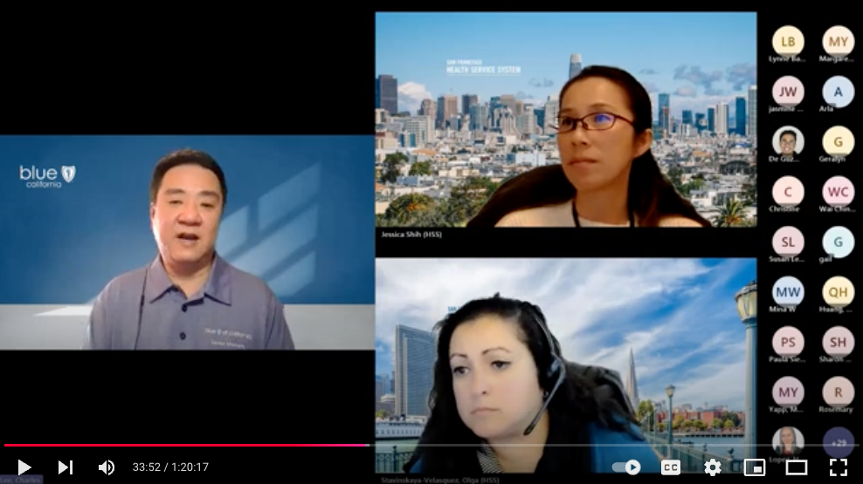
Open Enrollment Engagement Update
6 Webinars
3 Dedicated Blue Shield Deep Dive webinars with an average of 92 participants.
3 General HSS Medicare Plans webinars with an average of 69 participants.
Common questions included gym membership differences, access to Walgreens, OptumRx, and access to providers.

Slide 10
Member Engagement
Open Enrollment Email Engagement
Goal: > 50% Open Rate
QR Code Response From Mailed Letters
Goal: > 100
Blue Shield Medicare Interest
Goal: > 100
Webinars
Goal: > 80

Slide 11
HSS Call Metrics – Pre-Open Enrollment
Call Volume
Support Drivers Metrics
197 BSC transition calls handled Aug. 5th—Sep. 27th
Number of In-Person Interactions
HSS to BSC Calls
5 BSC transition interactions handled Aug. 5th—Sep. 27th
178 HSS -> BSC Calls Members connecting with BSC through the HSS phone system
Average Speed to Answer*
Goal: <180 secs
Average Handle Time*
Goal: <10 min
First Contact Resolution
Goal: >75%
130 secs Aug. 5th—Sep. 27th
12.82 minutes Aug. 5th—Sep. 27th
91% Aug. 5th—Sep. 27th
*Data reflects all retiree queue calls

Slide 12
HSS Call Metrics – Open Enrollment
Call Volume
Support Drivers Metrics
120 BSC transition calls handled Sep 30th—Oct 25th
Number of In-Person Interactions
HSS to BSC Calls
27 BSC transition interactions handled Sep 30th—Oct 25th
822 HSS -> BSC Calls Members connecting with BSC through the HSS phone system
Average Speed to Answer*
Goal: <180 secs
Average Handle Time*
Goal: <10 min
First Contact Resolution
Goal: >75%
253 secs Sep 30th—Oct 25th
13.9 minutes Sep 30th—Oct 25th
94% Sep 30th—Oct 25th
*Data reflects all retiree queue calls

Slide 13
Blue Shield Update

Slide 14
Blue Shield MAPD-PPO Transition Dashboard
Week ending on 11/01/2024
Workstream | Status | Target date | Key Call Outs
Implementation Planning | On Track | On going | Proceeding as planned.
Materials – Communications and OE Readiness | On Track | July-October | Proceeding as planned.
Customer Care Readiness | Complete | August | Customer Care up and running.
Benefit Plans, Benefit Documents, Contracts, and Agreements | On Track | Mid-August to December | Proceeding as planned.
Group Structure / Group Structure Reporting (GSR) | Complete | August 8 | Completed on time.
Electronic File Enrollment and ID Card Mailing | At Risk | November 25 December 2 | SFHSS to send enrollment file 12/2 & ID cards triggered in mid-December
Medical Transition for Prior Authorizations - Medicare | On Track | 11/1, 1/13 | Despite the challenges in gathering Prior Authorization data from UHC, Blue Shield of California will fulfill the CMS requirement for the 90-day continuity of care, including prior authorizations previously approved with no member action required.
Pharmacy Transition | On Track | August-January | Proceeding as planned.
Post Implementation | Not Started | February | TBD.
Status:
On Track
At Risk
Missed
Complete

Slide 15
Opportunity for Improvement
Medicare Stars
The Center for Medicare & Medicaid Services, also known as CMS, recently released its Medicare Star rating in October 2024, based on 2023 Plan Year results.
The Blue Shield Medicare PPO plan dropped by 1 star from 3.5 Stars to 2.5 Stars. SFHSS Medicare PPO retirees are not included in this rating.
SFHSS members' plans will start in January 2025, which will be reflected in the scores that CMS will release in October 2026.
A significant contributing factor to the rating drop in 2023 was member engagement with their preventative care screenings and wellness visits.
These Star Ratings do not change our commitment to ensuring SFHSS Medicare members have a smooth transition with access to the same doctors, the prescription medications they need, and timely claims payment.
Blue Shield has learned a lot about how we can improve member engagement since 2023, and these learnings have translated into the special support Blue Shield has been providing SFHSS members including:
Dedicated Concierge Member Service, custom microsite, and close partnership between HSS Staff and BSC to customize communication strategies for member education.

Slide 16
Addressing Member Concerns
News About Blue Shield’s Reduction in Force
As a nonprofit health plan, Blue Shield of California is driven by our mission to provide access to high quality health care that’s sustainably affordable. With members at the center of everything we do, ensuring we have the right roles, talent, skills, and capabilities in place to deliver on our mission is critical.
With that in mind, we’ve reduced our staff by 61 positions, or less than 1% of our workforce. These layoffs are largely due to the closure of one of our Blue Shield Promise clinics in Southern California. We do not anticipate any SFHSS member impact.
Blue Shield continues to be a very financially sound organization and recently given an ‘A’ financial strength rating with accompanying ‘stable’ outlooks affirmed by Fitch and A.M. Best.
This impact is not related to the Stars rating reduction.
Pharmacy - Network
Walgreens is included in the Blue Shield network but is not a preferred pharmacy. Only preferred pharmacies offer a 100-day supply for the cost of 2x copay.

Slide 17
Addressing Member Concerns
Pharmacy - Mail Order or Local Pharmacy
Members who currently have Mail Service Pharmacy for their maintenance medications will automatically have their prescriptions transferred to Amazon Pharmacy for fulfillment.
Instructions will be mailed to current mail service members on how to create an Amazon Pharmacy account to continue to receive their home mail service.
Mail delivery with Amazon Pharmacy is optional. Members can choose what works best for them: mail delivery via Amazon Pharmacy or filling prescriptions at their local retail pharmacy.
There are retail pharmacy options that may also allow members to receive home delivery for their prescriptions.
Members have the choice to transfer their maintenance medications to a retail pharmacy that may offer home delivery. If the pharmacy of choice is a Blue Shield preferred retail pharmacy, the member cost share is the same as the home delivery with Amazon Pharmacy.

Slide 18
BSC Call Metrics – Pre-Open Enrollment
Call Volume
Support Drivers Metrics
1,591 BSC transition calls handled Aug. 5th—Sep. 27th
Number of In-Person Interactions
BSC to HSS Calls
2 BSC transition interactions handled Aug. 5th—Sep. 27th
242 BSC-> HSS Calls Members connecting with HSS through the BSC phone system
Average Speed to Answer
Goal: <180 secs
Average Handle Time
Goal: <10 min
First Contact Resolution
Goal: >75%
18 secs Aug. 5th—Sep. 27th
15 minutes Aug. 5th—Sep. 27th
99% Aug. 5th—Sep. 27th

Slide 19
BSC Call Metrics – Open Enrollment
Call Volume
Support Drivers Metrics
2,608 BSC transition calls handled Sep 30th—Oct 25th
Number of In-Person Interactions
BSC to HSS Calls
66 BSC transition interactions handled Sep 30th—Oct 25th
844 BSC-> HSS Calls Members connecting with HSS through the BSC phone system
Average Speed to Answer
Goal: <180 secs
Average Handle Time
Goal: <10 min
First Contact Resolution
Goal: >75%
16 secs Sep 30th—Oct 25th
14 minutes Sep 30th—Oct 25th
100% Sep 30th—Oct 25th

Slide 20
Blue Shield Microsite Data – Pre-Open Enrollment
Top Visited Links on SFHSS Microsite: August 5 – September 29
Top Visited Micro Site Pages | Page Views
BSC Find A Doctor Link | 1,636
Transition Flyer | 828
Pharmacy Locator | 675
Formulary Search Tool | 653
Formulary PDF | 599
Medicare Participating Providers Tool | 424
Providers Outside of CA | 389
Telephone Number | 21

Slide 21
Blue Shield Microsite Data – Open Enrollment
Top Visited Links on SFHSS Microsite: September 30 – October 25
Top Visited Micro Site Pages | Page Views
BSC Find A Doctor Link | 686
Evidence of Coverage | 201
Pharmacy Locator | 185
Formulary Search Tool | 1,225
Formulary PDF | 285
Plan Video | 483
Summary of Benefits | 394
Telephone Number | 15

Slide 22
Blue Shield Kudos
Barbara from San Francisco shared that she is an 82-year-old retiree and was thrilled when she spoke to Jasmin. Barbara shared that Jasmin was very patient and professional and took the time needed to walk me thru how to navigate the microsite, in essence holding my hand.
Daniel from Escalon called in to share he just got off the phone with Samantha who was able to answer all his questions about the change from UHC to BSC and provide reassurance. Samantha was perfect and I sure do appreciate how thorough and knowledgeable she was.
Gayle from San Francisco shared that she had a wonderful experience with Gabby who spent a lot of time with her, and she sure appreciated that!
Larry from San Francisco shared that he spoke to Sandra who truly went above and beyond to help him and his wife understand plan types. Sandra connected SFHSS with me and helped me navigate ensuring the update was made. To sum it up ”Let me tell you Sandra is terrific.”
Clifford from Berkeley called to share that he truly enjoyed his conversation with Demonte. Clifford wanted to commend Demonte, not only on his listening skills but also on his overall excellent assistance; he couldn’t have asked for a better experience.

Slide 23
Looking Ahead
We are confident that our nearly 18,500 members who were part of the UnitedHealthcare MAPD PPO plan will be successfully transitioned to Blue Shield Medicare PPO with minimal interruption, effective January 1, 2025.
Although we are disappointed in Blue Shield’s drop in Medicare Star Rating for 2025, we are confident this will not reflect the customer service and care our members will receive.
Blue Shield has provided our members with a dedicated Concierge Member Services team and a custom microsite. We also have a close partnership with Blue Shield leadership allowing us to customize communication strategies for member education.
Working with AON, we have developed a scorecard benchmarked against the care and services provided to our members under UnitedHealthcare. This will be used to monitor and ensure our members continue to receive the same level of care and service with Blue Shield. The measurement areas are:
Preventative care and screenings
Drug adherence
Medical care and disease management

Slide 24
Questions?

