Slide 1
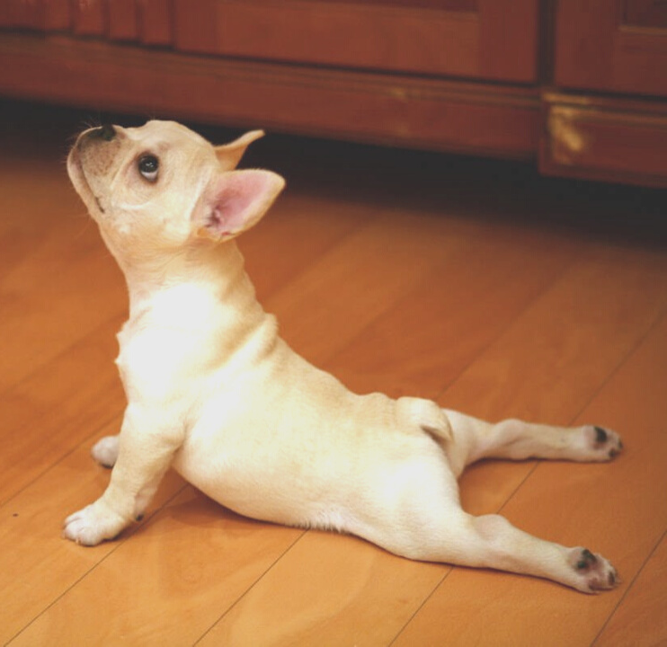
Practice Self-Care:
De-stress through movement
Take a quick walk or
do a simple stretch
Learn more on sfhss.org/well-being

Slide 2
Practice Self-Care:
Get outside
Nature, fresh air and sunshine are good for our nervous system and can help fight off stress and anxiety
Learn more on sfhss.org/well-being

Slide 3
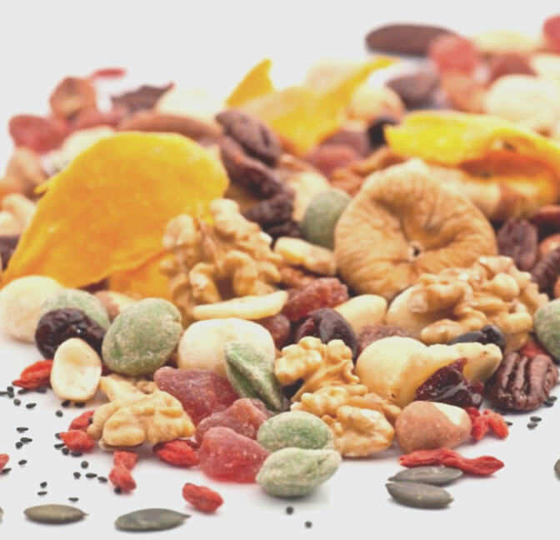
Practice Self-Care:
Eat
"feel-good" food
Choose healthy snacks to boost your energy and improve your mood!
Learn more on sfhss.org/well-being

Slide 4
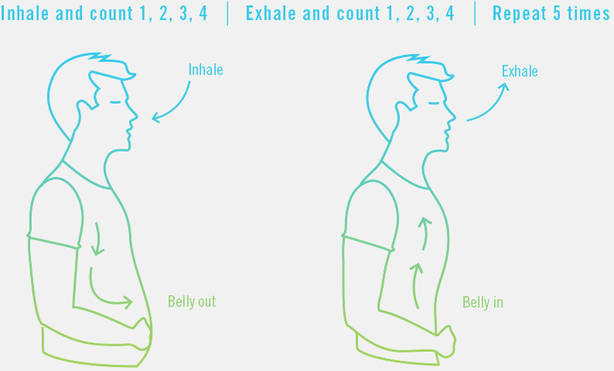
Practice
Self-Care:
Take a breath
Relieve tension with one minute of 4-count deep breathing
Learn more on sfhss.org/well-being

Slide 5
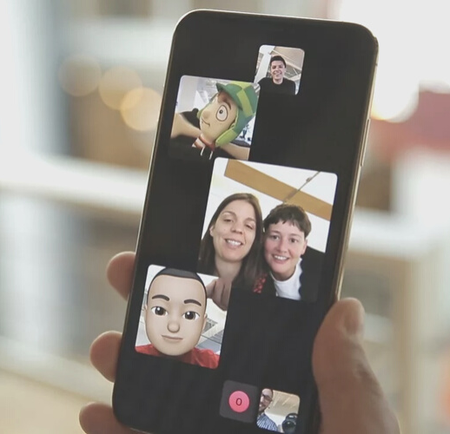
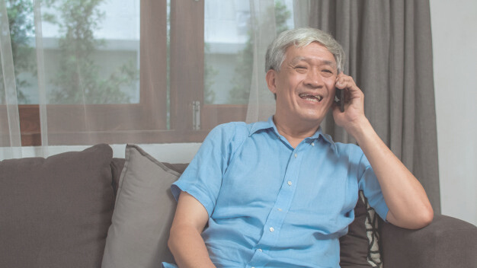
Practice
Self-Care:
Connect with family, friends, & coworkers
Call or video chat to say hello, share a laugh, and provide support to one another with kindness and compassion
Learn more on sfhss.org/well-being

Slide 6
Practice
Self-Care:
Think of 3 things you're grateful for
Take a minute to remind yourself of what or whom you're thankful for and why your're thankful for all 3!
Learn more on sfhss.org/well-being

Slide 7
You are doing great work, in a time of
great need

Slide 8
Remind Yourself:
We're all in this together

Slide 9
Celebrate small wins as BIG victories

Slide 10
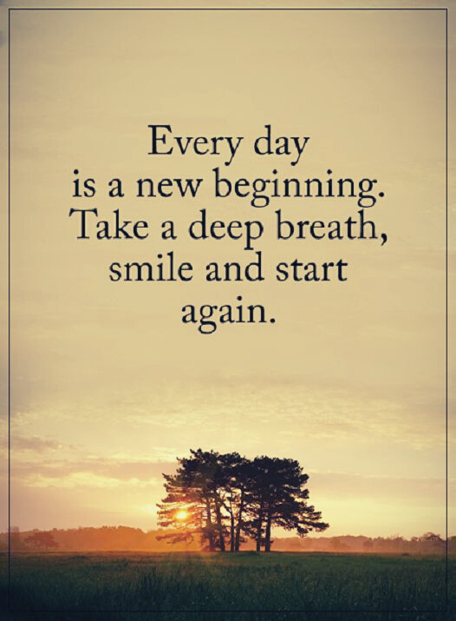
Everyday is a fresh start

Slide 11
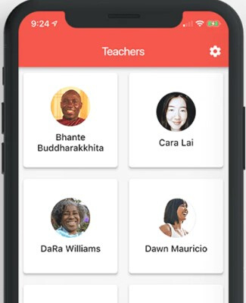
Try this stress management tool!
Liberate is a mobile app created by and for people of color. This app provides you culturally relevant guided meditations.
FREE and Available for Apple and Android

Slide 12
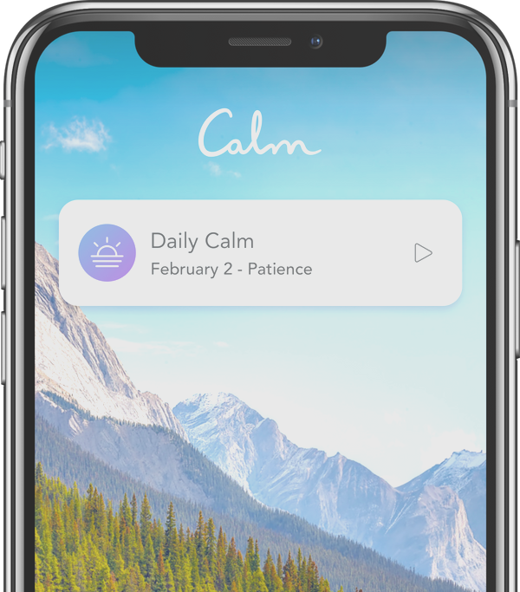
Try this stress management tool!
Calm is a mobile app to help you meditate, sleep, and practice relaxation through storytelling, music, and guided meditation.
FREE trial available for Apple and Android

Slide 13
Try this stress management tool!
Headspace is a guided meditation app with tools to help with mindful eating, walking meditation, and sessions to reduce anxiety in stressful moments.
FREE subscription for healthcare workers
headspace.com/health-covid-19

Slide 14
EAP is now available 24/7.
Call the Employee Assistance for tele-counseling (800) 795-2351
Learn more about the EAP and resources available to you sfhss.org/eap

Slide 15
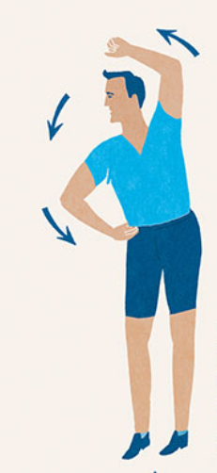
De-stress with this:
Teapot Stretch
Stand with your feet shoulder width apart
Place your right hand on your hip
Place your left hand over your head
Gently bend your upper body to the right, so you feel a stretch
Hold for 2 seconds
Slowly return to the center
Repeat on other side

Slide 16
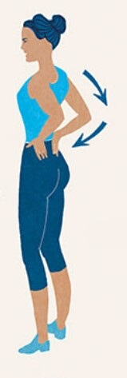
De-stress with this:
Back Stretch
Place your palms on your lower back
Gently lean back, for a light stretch
Return to the standing position
Be sure not to lean back too far
Repeat 2-3 times

Slide 17
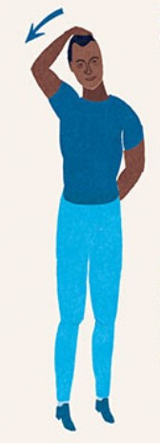
De-stress with this:
Neck Stretch
Reach over your head and place your right hand gently on your head
Slowly and gently tilt your head away from your left shoulder for an easy stretch
For a deeper stretch, slowly let your left shoulder drop down
Repeat on the other side

Slide 18
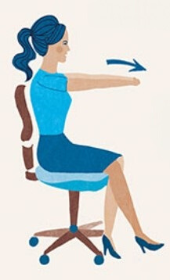
De-stress with this:
Shoulder Stretch
Interlock your hands in front of you
Turn palms away from the body
Gently straighten elbows and reach forward
Hold stretch for 20-30 seconds.
Repeat

Slide 19
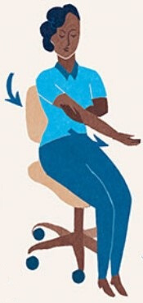
De-stress with this:
Shoulder Pull
Hold under your right upper arm
Pull across your chest towards yourself
Hold the stretch for 20-30 seconds
Repeat with your other arm

Slide 20
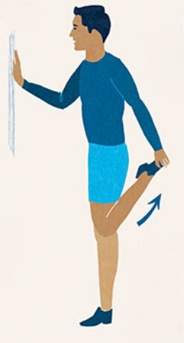
De-stress with this:
Quadricep Stretch
Stand on one leg with your knees touching
Use a chair or wall for support
Grab your right foot with your right hand
Pull toward your rear
Hold for 20-30 seconds
Repeat with other leg

Slide 21
We Appreciate you.
Not all heroes wear capes-
THANK YOU
for the heroic work you do every day!
On behalf of
ADD DEPARTMENT NAME HERE,
Well-Being Champions
Thank You!

