Slide 1
eBenefits Registration

Slide 2
Our Goal
By the end of this training, you should:
Know how to or have registered for an eBenefits account
Be able to look up your current elections online
Make changes online during Open Enrollment or a Qualifying Life Event

Slide 3
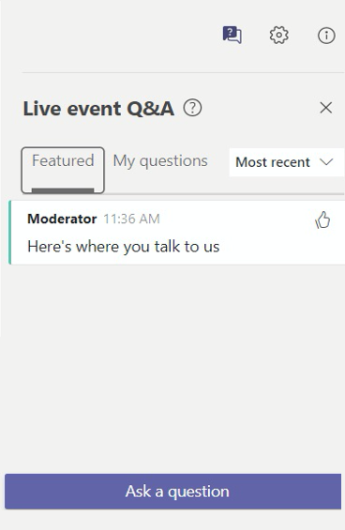
How this training is structured
You will be on mute for the entire presentation.
If you have questions:
Type them into Q&A box in your menu bar at any time by clicking
Scroll through your screen to find the menu bar either at the top or bottom of the screen depending on whether you’re using a computer or mobile device
Do not share your DSW number or any personal information
If your question is more complex or personal in nature, we recommend a 1:1 consultation
Notes:
This pandemic doesn’t just affect our physical health, but also our emotional health
All of our plans will be highlighting their benefits and the different ways you can access care
We want you to be well-informed as you make your benefit elections

Slide 4
Step-by-Step Instructions to Register for eBenefits
This is a one-time set-up for your eBenefits account.
This is only applicable for City College and SFUSD employees and all Retirees
This is only applicable if you have never set up an account before
If you have a current job with City and County of SF (CSF) or Superior Court (CRT) in addition to your job with either City College, SFUSD or being Retired, this is not applicable. You will use your ID / Password associated with your CSF/CRT job
You will have the ability to see current enrollment information.
The following slides are Step-by-Step Instructions on how to register your account.

Slide 5
The Steps to Registering for eBenefits
You’ll get your DSW # – DSW stands for Disaster Service Worker. This is not your Community College employee ID, San Francisco Unified School District employee ID nor is it a DSW you may have with your employer. It is your user ID in the eBenefits system. At this time there is no way to set a username.
You will need this ID so save it somewhere. If you forget it, you can call SFHSS. When you get your Open Enrollment materials, we will provide you with your DSW in the upper right corner of the letter.
You’ll set a password.
You’ll set up your Multi-Factor Authentication (MFA).
You’ll log into the system and view your benefits.

Slide 6
My Apps Dashboard

Slide 7
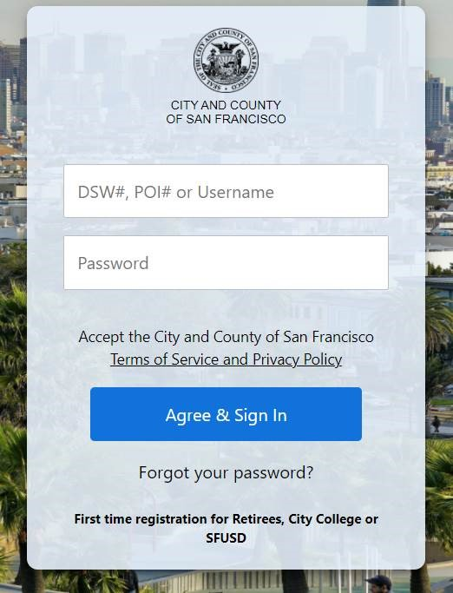
Step 1
1. Go to: https://myapps.sfgov.org
Click the “First Time Registration for Retirees, City College or SFUSD” link.

Slide 8
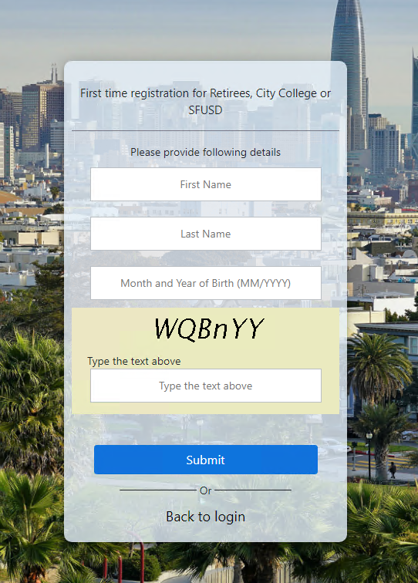
Step 2
Enter First Name, Last Name, Date of Birth as month and year, and type in the Captcha.
The letters in the captcha are case-sensitive. If the letter is larger, it is a capital letter. Lower case L looks like “l”.
If you would like to generate a new captcha, refresh your browser to begin again.

Slide 9
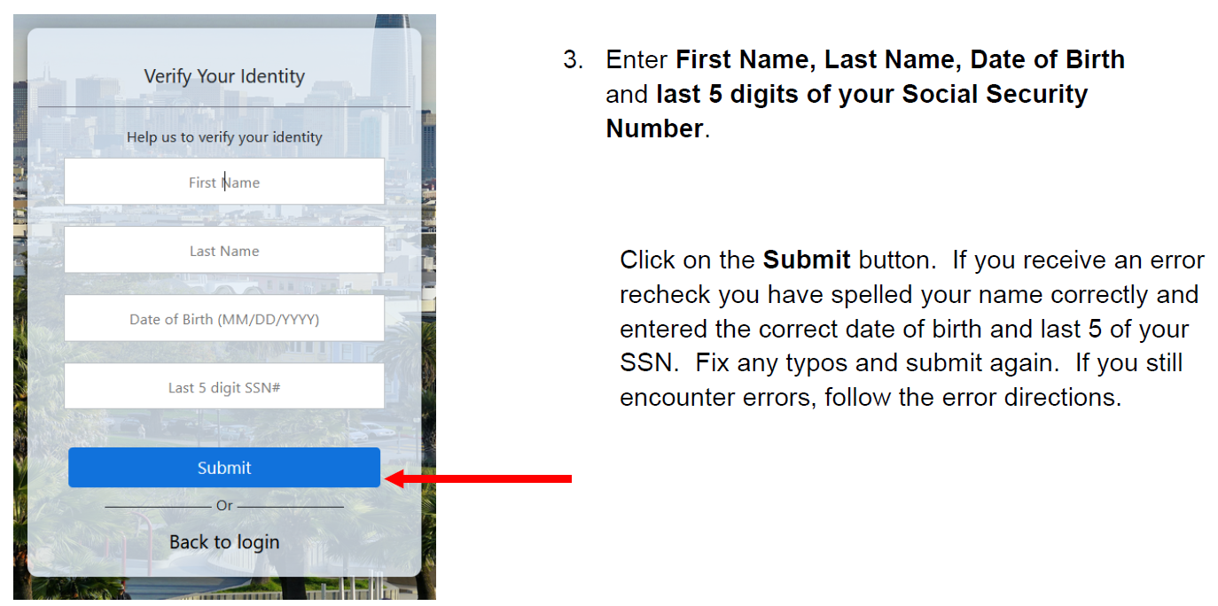
Step 3

Slide 10
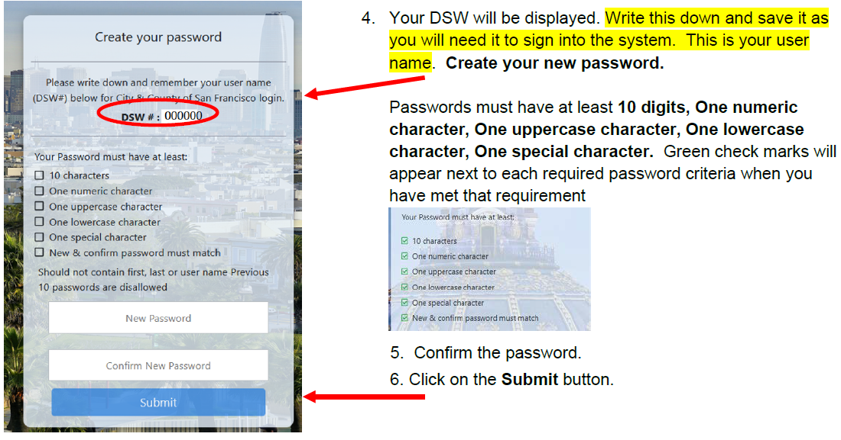
Steps 4-6

Slide 11
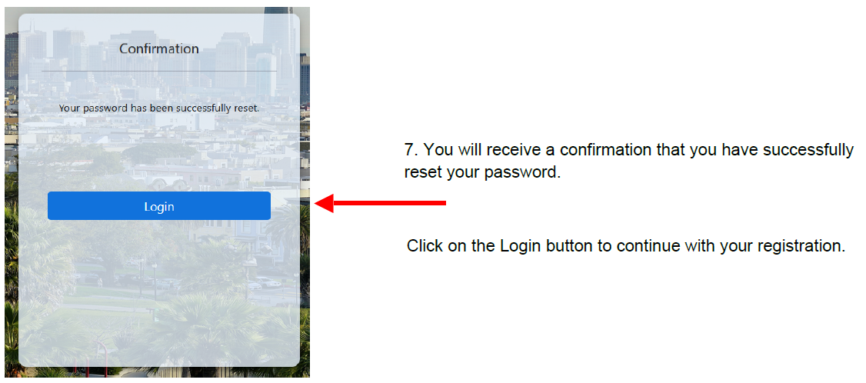
Step 7

Slide 12
Step 8

Slide 13
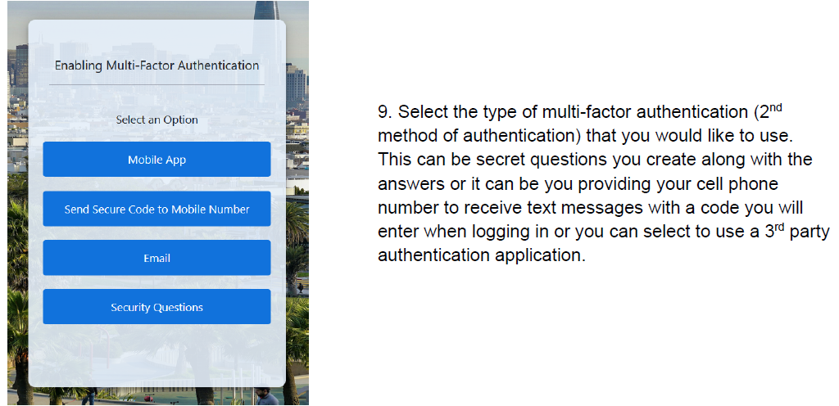
Step 9
Note: email option not supported.

Slide 14
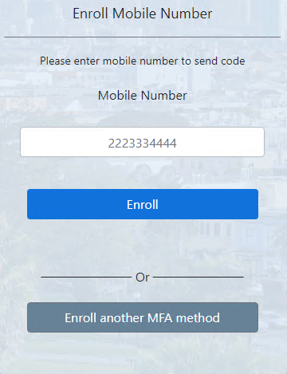
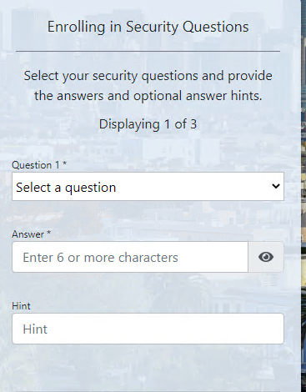
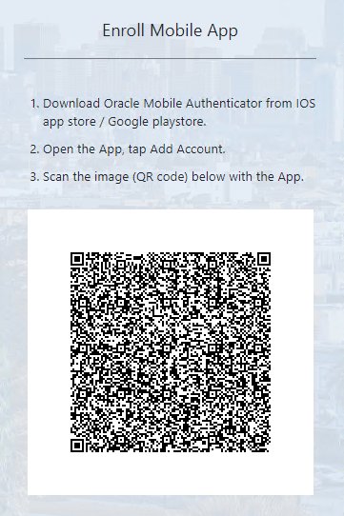
Step 10 – Select an MFA Option and Follow the Instructions
Note: email option not supported.

Slide 15
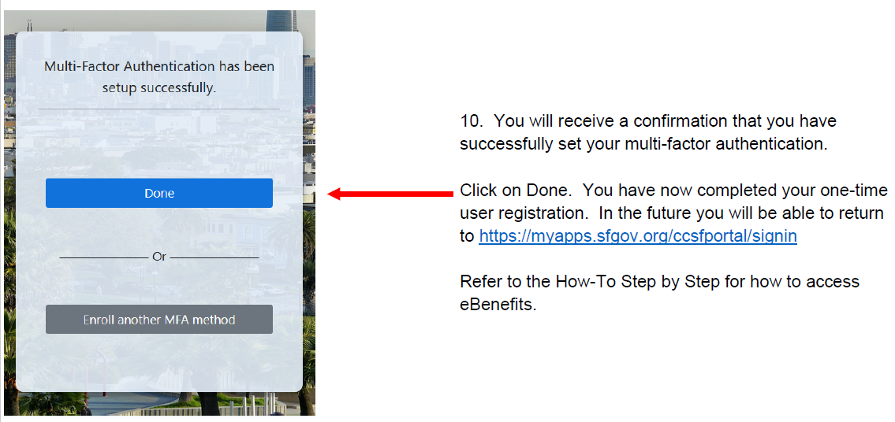
Step 11

Slide 16
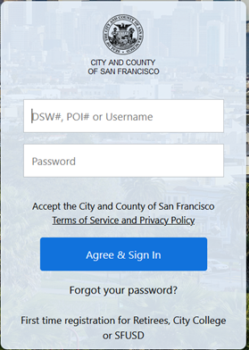
Viewing Your Current Elections and Making Changes Online
Go to the sign-in page: https://myapps.sfgov.org/
Enter your DSW ID and Password.
Click Agree & Sign In.
Complete the multi-factor authentication (MFA) steps.

Slide 17
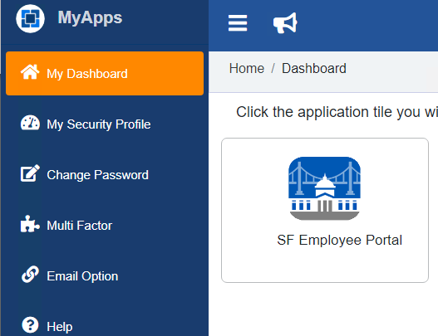
Viewing Your Current Elections and Making Changes Online
From the My Apps Dashboard click on the tile for the SF Employee Portal.
Note: The email address listed in your myapps profile may not be correct. This is a known issue. This email address is not used, and it cannot be changed at this time.

Slide 18
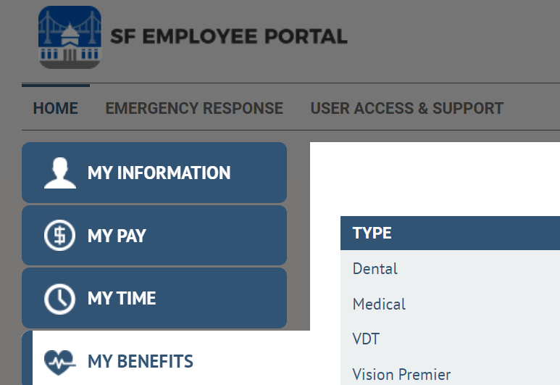
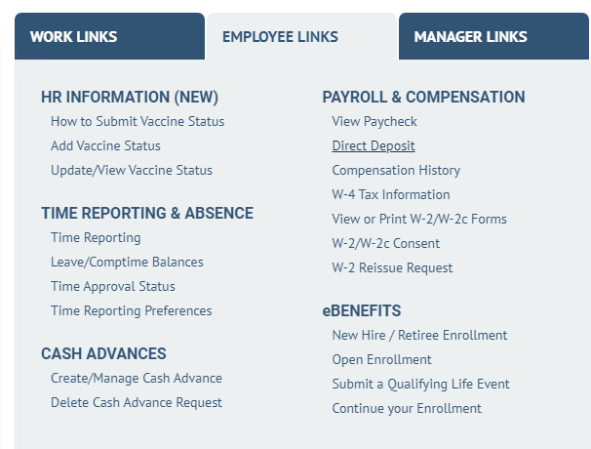
Viewing Your Current Elections
Click on My Benefits for the slide out which allows you to view your current elections.
Making Changes Online
Click on the My Links tab.
Click on Employee Links.
Under eBenefits select the appropriate link
When enrolling online, click next through each screen. You MUST click the submit button at the end to submit your enrollment.

Slide 19
Updating your Contact Information
City and County of San Francisco employees, Superior Court employees and retirees can update their contact information within the SF Employee Portal.
Community College of San Francisco employees and San Francisco Unified School District employees: At the request of your employer, you are unable to update your address online.
City College - Update your address in https://ramid.ccsf.edu or complete a CCSF Address Change Form. If you have any questions to contact CCSF Human Resources at (415) 452-7660.
SFUSD – Contact your department HR representative

Slide 20
Next steps…
Register your account!
Make your benefits elections online during Open Enrollment from October 1-29, 2021.
Visit https://myapps.sfgov.org/ to access eBenefits and bookmark this page.
Attend the “Navigating eBenefits to Make Open Enrollment Elections” webinar. Webinar links are available at sfhss.org
10/14 @ 1pm
10/25 @ 12pm

Slide 21
Help:
https://sfhss.org/eBenefits – you’ll find videos, step by step instructions and troubleshooting tips
If you can’t set up your account, contact City Department of Technology at (628) 652-5000. You must have your DSW number!
If you can create account but don’t have the SF Employee Portal tile, or need help changing your password, contact City Department of Technology at (628) 652-5000. You must have your DSW number!
If during Open Enrollment you cannot get into your OE event, have questions about navigating eBenefits, or questions about your benefits, contact SFHSS at (628) 652-4700.
Your DSW number will be provided in your OE letter, and it is also provided during registration process.

Slide 22
Questions

Slide 23
Enter SFHSS Raffle Prize Drawing
Many Ways to Enter to Win
Register for an account today
Make your elections using eBenefits
Complete form for attending today’s webinar
https://tinyurl.com/da2yente

