Slide 1
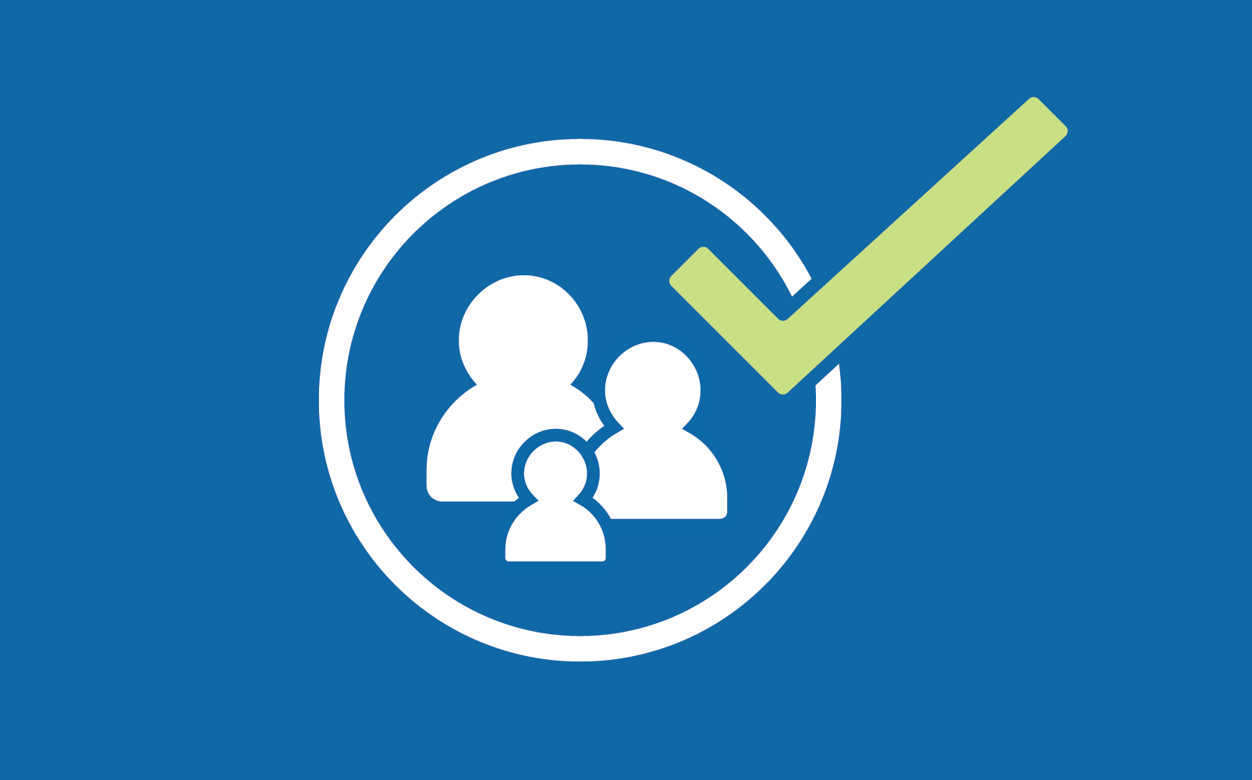
DEPENDENT
ELIGIBILITY
VERIFICATION
AUDIT
How to Drop a Dependent

Slide 2
What is DEVA?
DEVA stands for Dependent Eligibility Verification Audit.
The San Francisco Health Service System conducts DEVA audits to help contain costs for health care benefits. Section E of the Membership Rules state that SFHSS may require proof of dependent eligibility at any time.
Covering ineligible dependents puts health plan administrators at financial risk and increases overall health care costs for eligible members.
During a DEVA audit, members will be asked to provide documentation to verify their relationship with their dependent spouse or domestic partner is still current.
Failure to provide proof of dependent eligibility within the specified deadlines will result in ineligible dependents being dropped from health plan coverage. Coverage for any dependent children of an ineligible domestic partner and stepchildren (spouse's child) of an ineligible spouse will also be dropped.

Slide 3
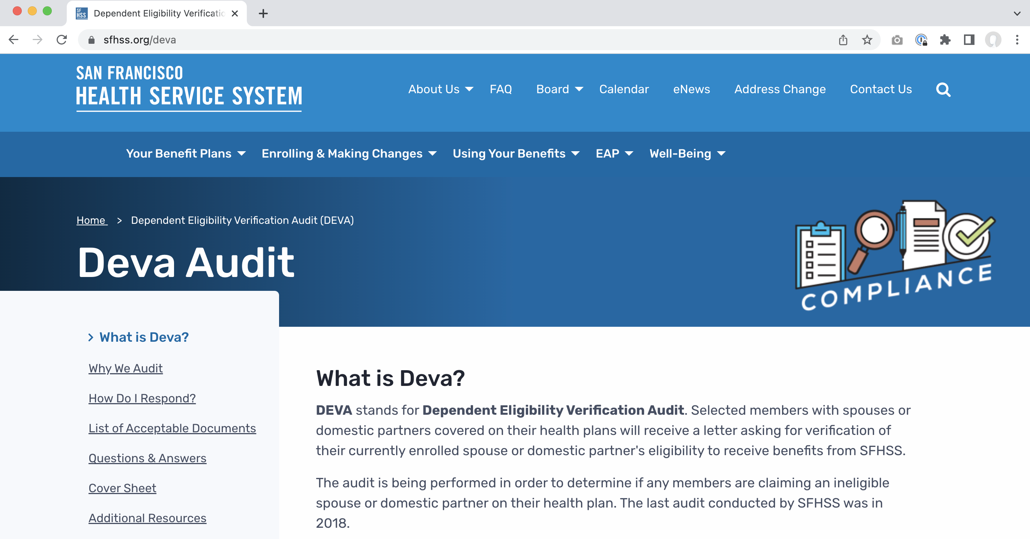
DEVA Homepage – sfhss.org/deva

Slide 4
How to Drop an Ineligible Dependent?
Follow the step-by-step instructions below to drop your ineligible dependent online. To learn more about DEVA, visit sfhss.org/deva.
How long do I have to respond? Please refer to your Notification Letter, which you received in the mail, for the deadline to submit your verification documentation. If you have any questions about the deadline to submit documentation, please call SFHSS at (628) 652-4700.
How do I drop my ineligible dependent? You can drop your dependent online by following the instructions below. You can also drop your dependent by completing an Enrollment Form and submitting it by fax or mail. Enrollment Forms can be downloaded at sfhss.org. Our fax number is (628) 652-4701 and our mailing address is SFHSS, 1145 Market Street, 3rd Floor, San Francisco, CA 94103.

Slide 5
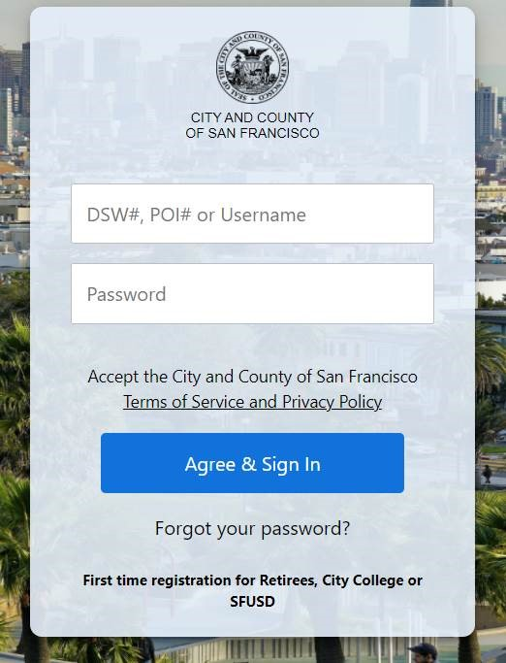
Step by Step to Drop Your Ineligible Dependents
Let’s Get Started…
Go to the San Francisco Employee Gateway https://myapps.sfgov.org/ccsfportal/signin Click on the San Francisco Employee Portal icon.
Enter your Employee ID and password. Click Agree & Sign In.
Complete the security verification and click Verify.
If you are a Retiree and have not previously registered for an account, click on “First time registration for Retirees, City College or SFUSD.” If you would like step by step instructions on how to Register Your Account (one-time only), visit sfhss.org/deva.

Slide 6
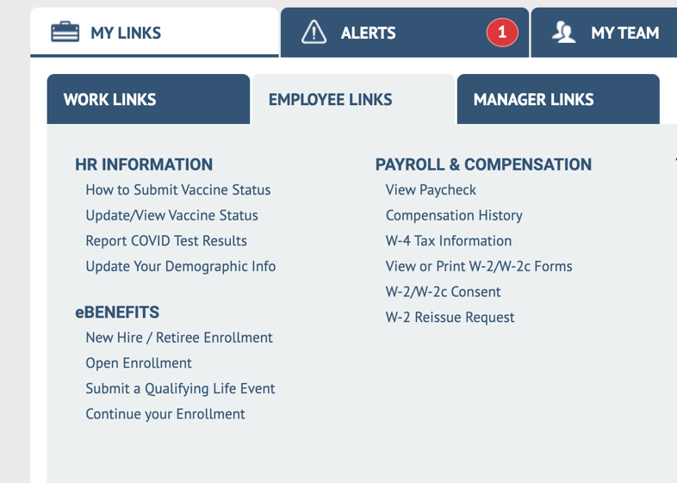
Step by Step to How to Upload Documentation
5. Under the Employee Links tab (under the My Links tab), click on Submit a Qualifying Life Event.

Slide 7
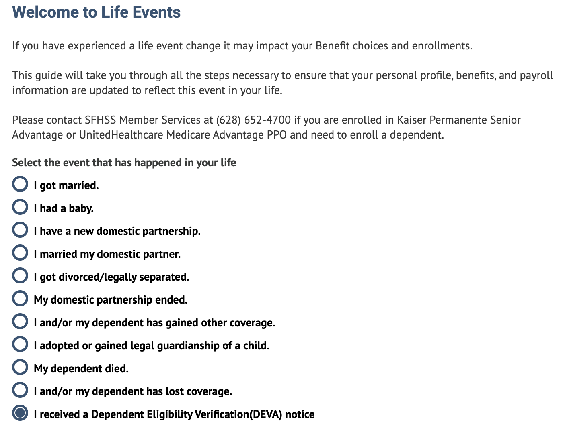
Step by Step to Drop Your Ineligible Dependents
6. Select “I received a DEVA notice” at the bottom of the list.
7. Click the Continue button.

Slide 8
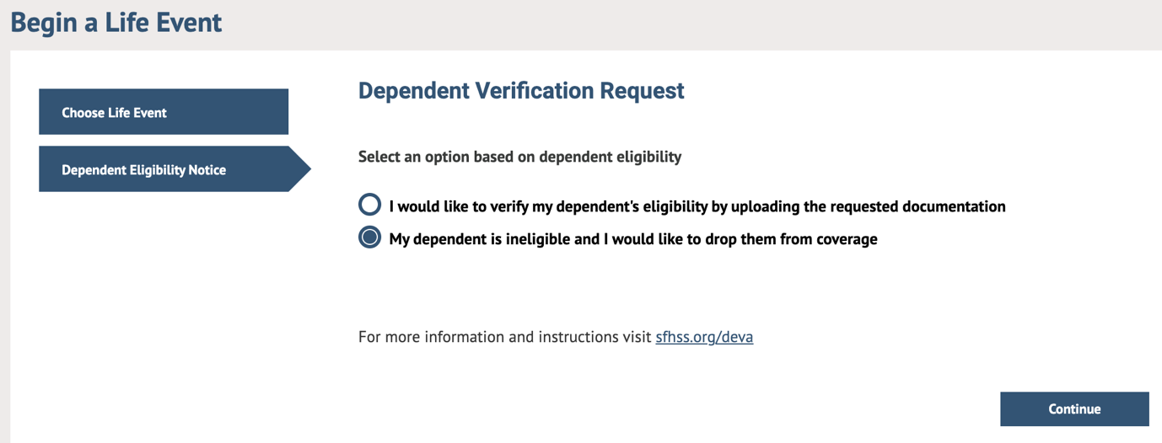
Step by Step to Drop Your Ineligible Dependents
Begin a Life Event – Dependent Verification Request
8. Select, “My dependent is ineligible, and I would like to drop them from coverage.”
9. Click on the Continue button.

Slide 9
Step by Step to Drop Your Ineligible Dependents
Your Life Event Has Been Submitted
10. After you click Continue, your screen will automatically begin processing a life event and your screen should read, “Your life event has been submitted.”
You can now begin the process of disenrolling your ineligible dependent from your existing benefit enrollment elections.
11. Click on the “Begin your Benefits Enrollment” button to continue.

Slide 10
Step by Step to Drop Your Ineligible Dependents
Enroll in Benefits
12. Click on the Edit button next to the ineligible spouse or domestic partner you want to dis-enroll from your benefits.

Slide 11
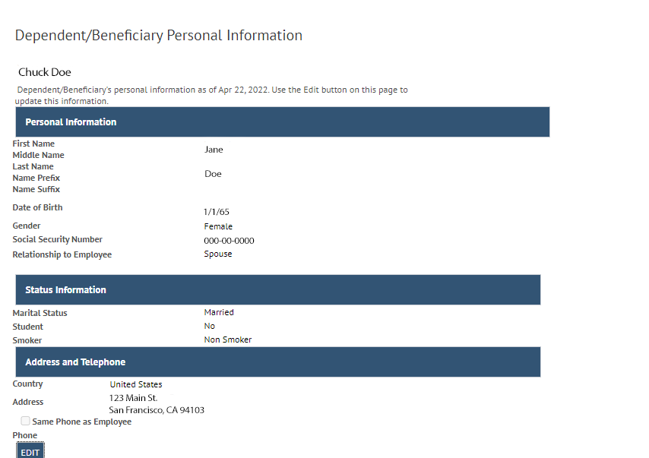
Step by Step to Drop Your Ineligible Dependents
13. You will need to update TWO items on the “Dependent/Beneficiary Personal Information” page:
Relationship to Employee
Marital Status

Slide 12
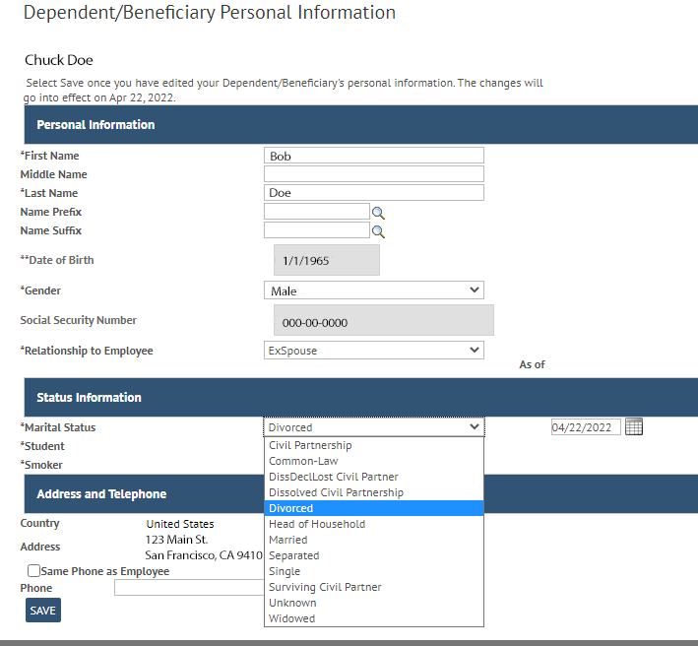
Step by Step to Drop Your Ineligible Dependents
14. Click on the Edit button. Next, click on the dropdown menu under “Relationship to Employee” and select either “ExSpouse” or “ExDomestic Partner.”
15. Then click on Marital Status and select the current status of your relationship with your ineligible dependent.
16. Hit the Save button to continue.

Slide 13
Step by Step to Drop Your Ineligible Dependents
17. After saving, you should no longer see your ex-spouse or ex-domestic partner listed as a dependent.

Slide 14
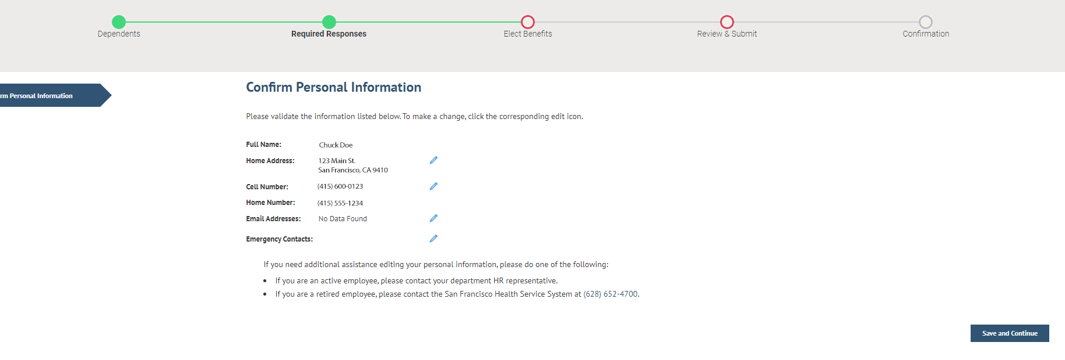
Step by Step to Drop Your Ineligible Dependents
Confirm Personal Information
18. If your ineligible dependent was your “Emergency Contact,” and this information has changed, please update, and click on the “Save and Continue” button.

Slide 15
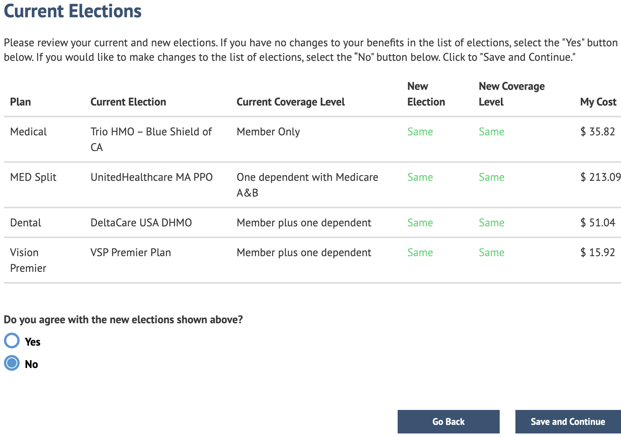
Step by Step to Drop Your Ineligible Dependents
Current Elections
19. Next, you will begin going through your current benefit elections, where you will need to dis-enroll your ineligible dependent from your medical, dental, and/or Vision Premier health plan coverage.
20. Select “No” under the question, “Do you agree with the new elections shown above?”
Click the “Save and Continue” button.

Slide 16
Step by Step to Drop Your Ineligible Dependents
Choose a Medical Plan
21. Disenroll your ineligible dependent by deselecting the box under Enroll next to your ineligible dependent’s name. Click the “Save and Continue” button.

Slide 17
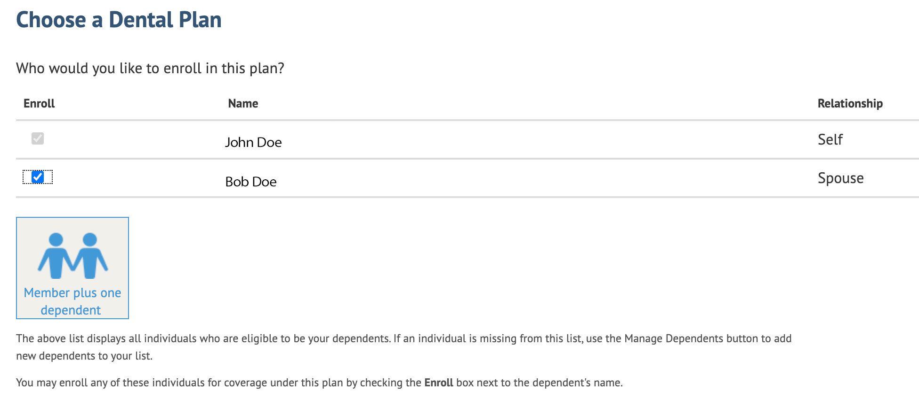
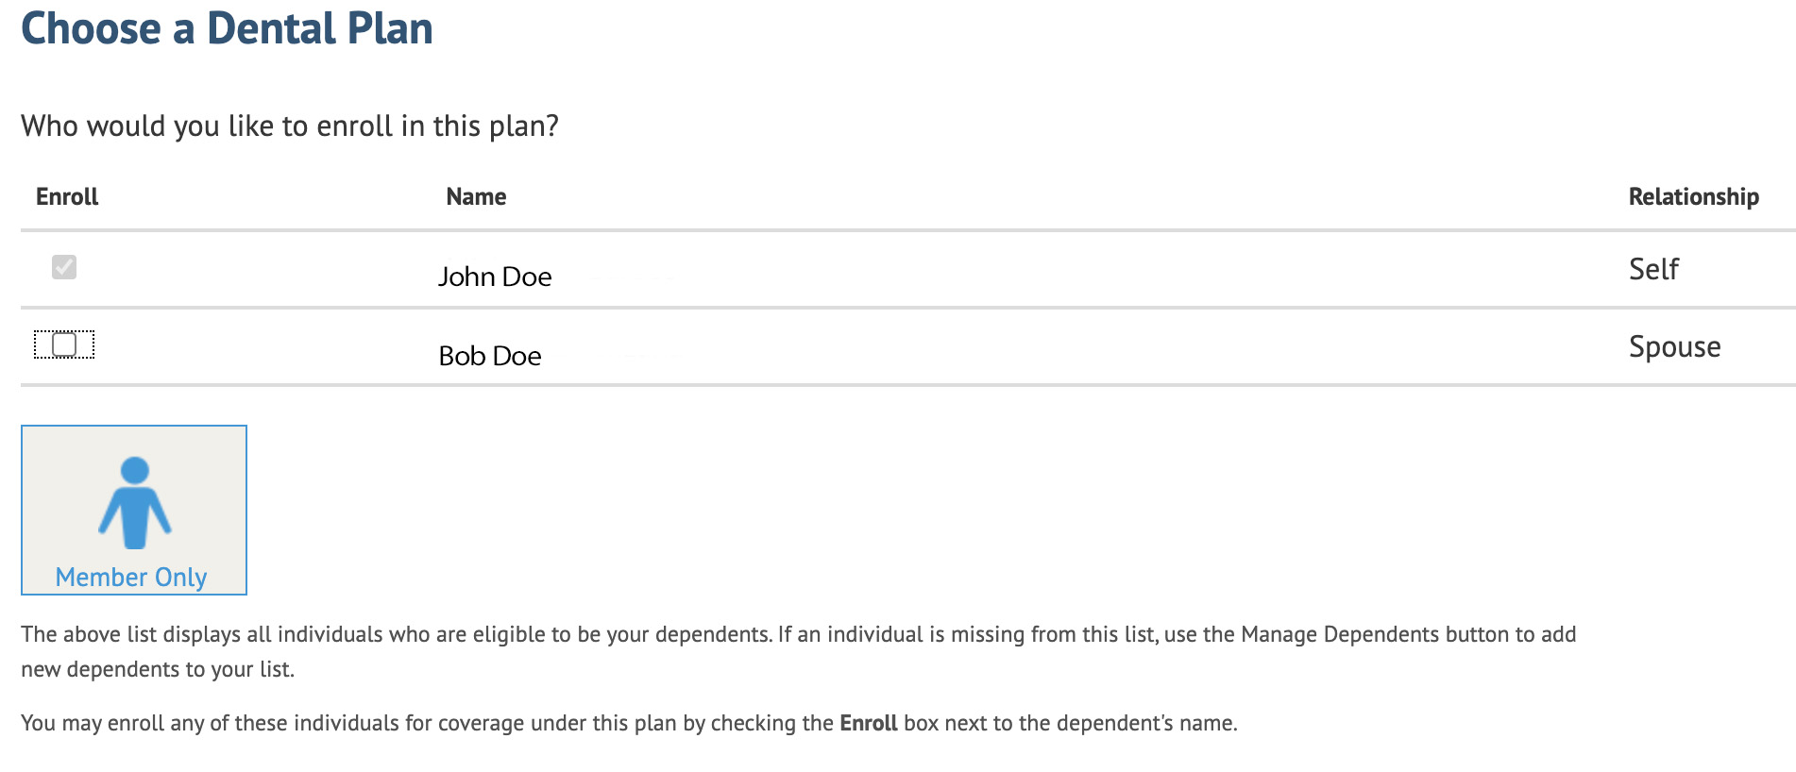
Step by Step to Drop Your Ineligible Dependents
Choose a Dental Plan
22. Disenroll your ineligible dependent by deselecting the box under Enroll next to your ineligible dependent’s name.
Click the “Save and Continue” button.

Slide 18
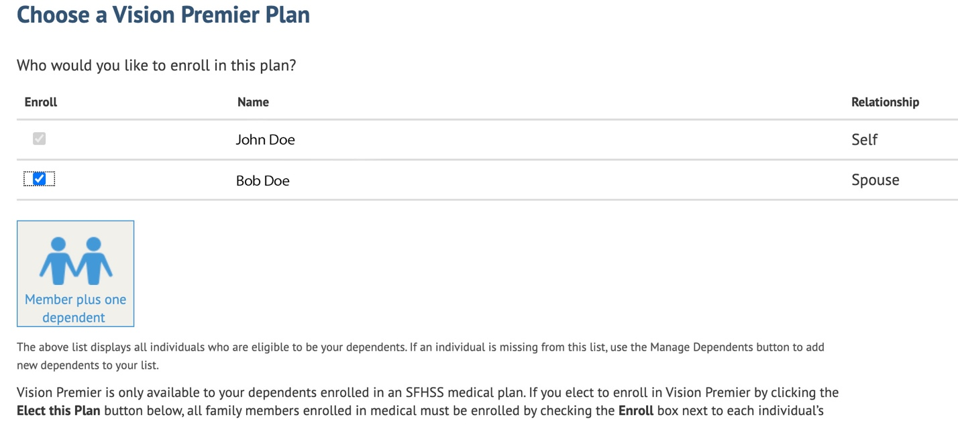
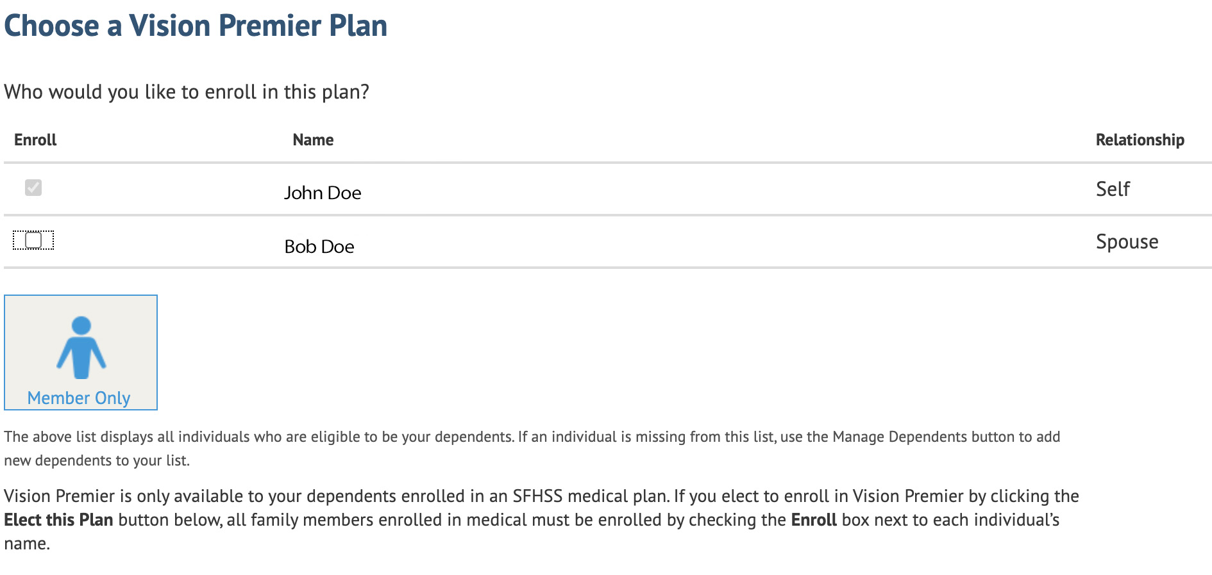
Step by Step to Drop Your Ineligible Dependents
Choose a Vision Premier Plan
23. Disenroll your ineligible dependent by deselecting the box under Enroll next to your ineligible dependent’s name.
Click the “Save and Continue” button.

Slide 19
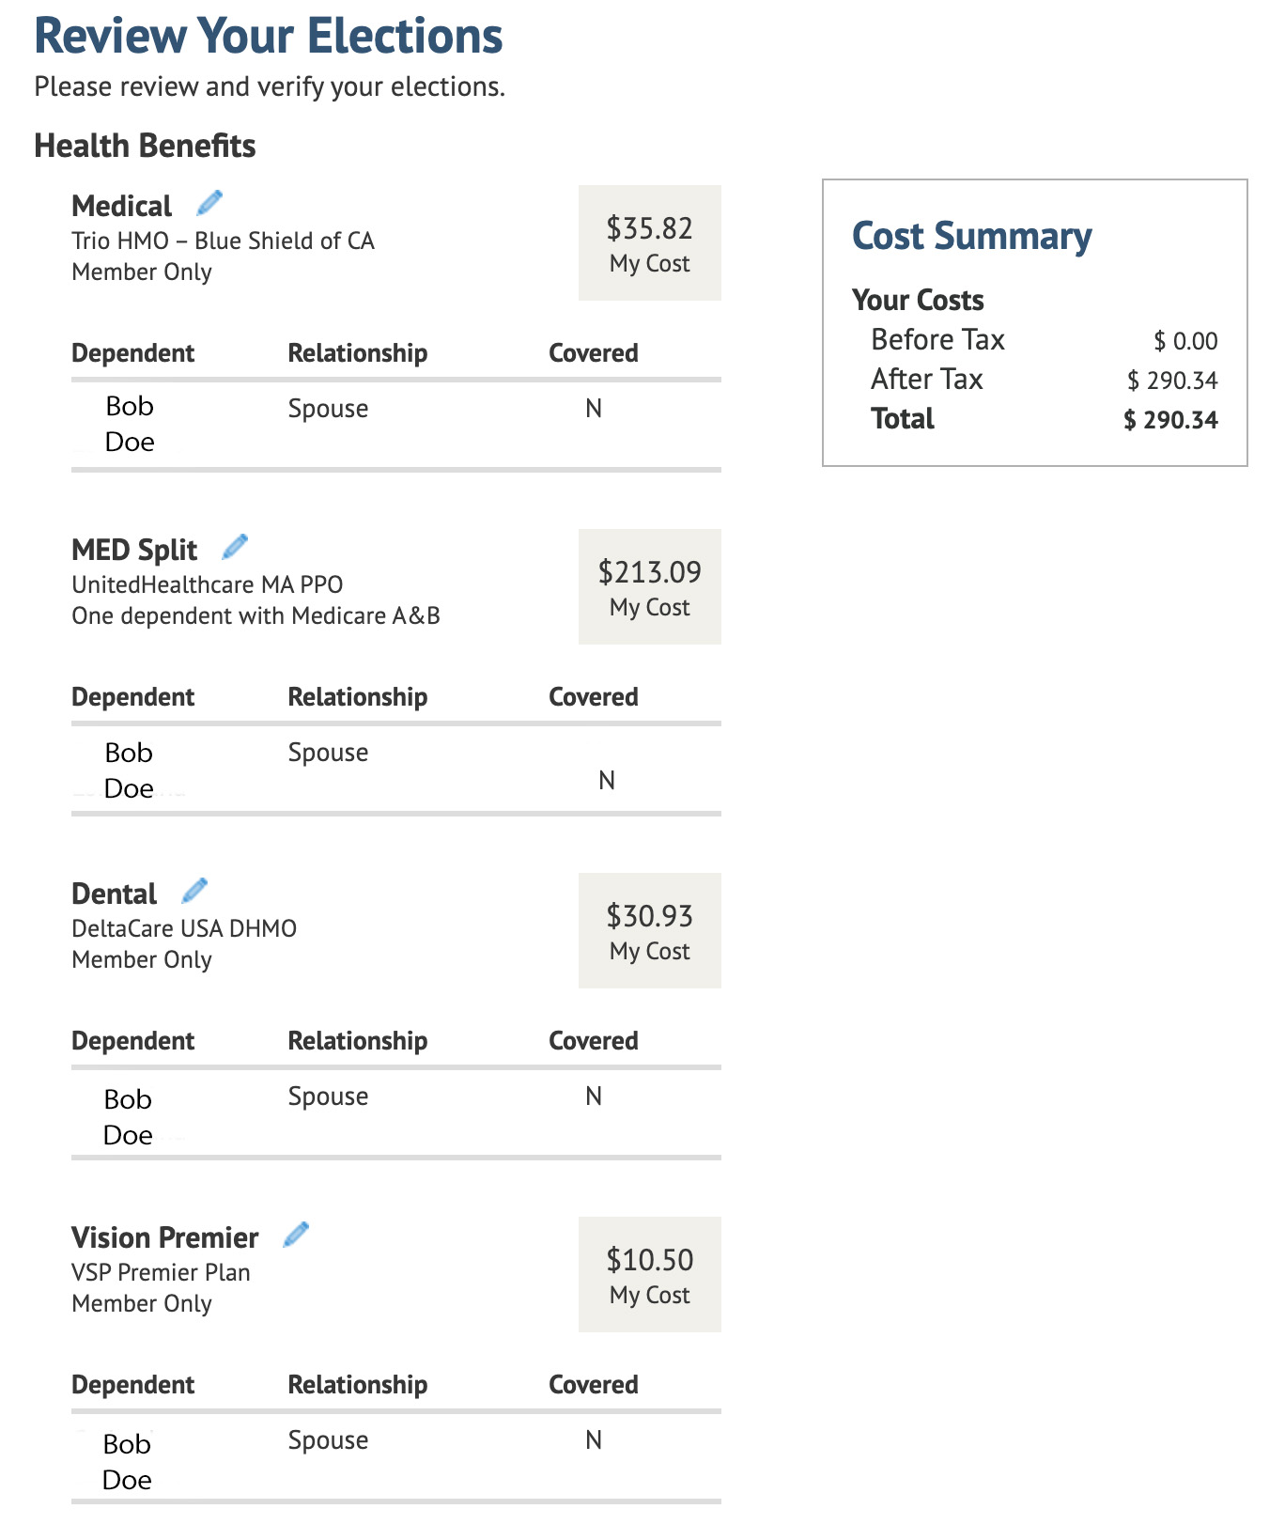
Step by Step to Drop Your Ineligible Dependents
Review Your Elections
24. This is your opportunity to review your elections.
To edit a section, click on the pencil.
Click the Continue button.
If you need to go back to a previous screen, use the breadcrumbs at the top of the page to navigate there.

Slide 20
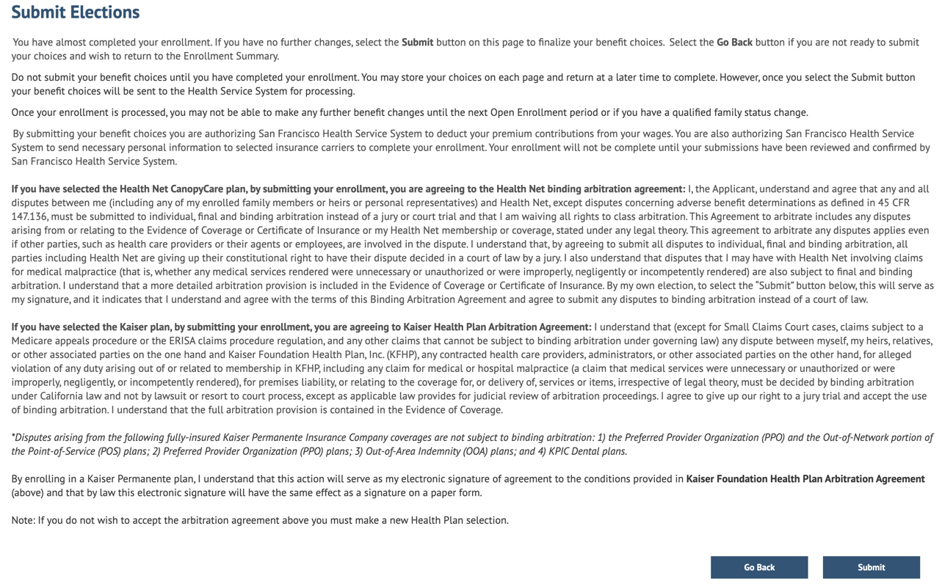
Step by Step to Drop Your Ineligible Dependents
Submit Elections
25. Click the “Submit” button. Your previous elections dropping your ineligible dependent from your health plan coverage have been submitted and will be reviewed and processed by SFHSS.

Slide 21
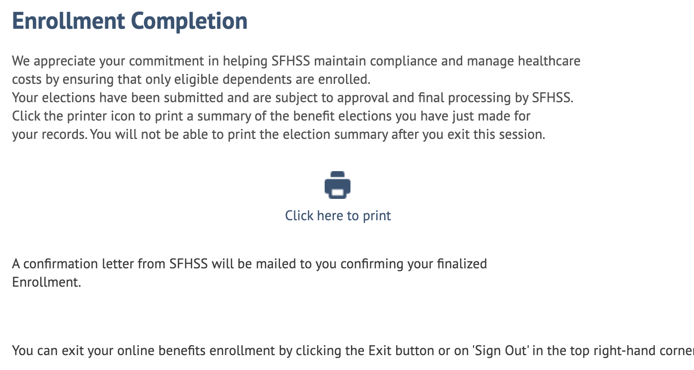
Step by Step to Drop Your Ineligible Dependents
Enrollment Completion
26. Exit by clicking Exit or Sign Out in the top right-hand corner of the page. Congratulations!
You have successfully removed your ineligible dependent from your health plan coverage.
Your documentation will be reviewed by SFHSS and you will receive a letter in the mail regarding the status of your submission.

Slide 22
Questions?
Problems logging in? Need to reset your password? If you experience technical issues accessing your account and cannot resolve with our online resources or need to reset your password, call SFHSS at (628) 652-4700.
Our phone hours are Monday, Tuesday, Wednesday and Friday from 9am to 12pm and 1pm to 5pm and on Thursdays from 10am to 12pm and 1pm to 5pm. Phone number: (628) 652-4700.
Fax number: (628) 652-4701.

