Slide 1

UnitedHealthcare Dental
Built to help protect overall health, close gaps in care
and take a smaller bite out of budgets
Open enrollment Oct. 2nd – 27th
Notes:
08.003.001 | 21-654353 | EI21654352

Slide 2
Who’s eligible?
Dental | Dental Plans
Employees and Retirees
Eligible dependents
Spouse/domestic partner
Child(ren) – Up to the age of 26
Notes:
Notes:

Slide 3



Oral health is connected to overall heath
Dental | Dental Plans
17.5%
of adults have a high-risk condition¹
Diabetes, asthma heart disease and pregnancy are just some of the conditions that may be linked to oral health
~2x
more likely to have heart disease² if you have gum disease
¹ UnitedHealthcare gap in care integrated report, 2019.
² Mathews MJ, Mathews EH, Mathews GE. Oral health and coronary heart disease. BMC Oral Health. 2016;16(1):122. Published online Nov. 15, 2016. doi: 10.1186/s12903-016-0316-7.
Notes:
Notes:
Good oral health may be linked to reducing the cost and complications of many high-risk, costly conditions such as diabetes and heart and kidney disease.¹
Our whole-person approach is designed to link medical and dental data to help close gaps in dental care for employees with chronic conditions, with the goal of helping improve overall health and lower costs.
Gaps in oral care are characterized as a lack of oral health care received within the previous 6 months as well as the type of oral health care being received (e.g., has the employee gotten appropriate periodontal/preventive care for their condition?). We outreach to identified employees to help them close their dental care gaps, which may help them achieve better health and save money.
Condition-specific data:
Diabetes: People with diabetes are more likely to have gum disease. If left untreated, this can make it difficult for them to stabilize their blood sugar. However, those who receive gum disease treatment may see a positive impact on their blood sugar levels.²
Heart health: People with gum disease are nearly twice as likely to have heart disease.³
Pregnancy: Gum disease in pregnant women may be linked to complications such as pre-term birth and low birth weight.⁴
Asthma: Employees taking asthma medication may be at risk of cavities, dental erosion, periodontal diseases and oral candidiasis.⁵
Kidney disease: Treating gum disease helps reduce inflammation, which can reduce the risk of kidney failure.⁶
Chronic obstructive pulmonary disease (COPD): Periodontal disease may increase the risk for respiratory disease.⁷
Sources:
¹ American Academy of Periodontology. Periodontal disease and systemic health. perio.org/consumer/gum-disease-and-other-diseases. Accessed Aug. 14, 2020.
² Ibid. Diabetes and periodontal disease. perio.org/consumer/gum-disease-and-diabetes.htm. Accessed August 2020.
³ Mathews MJ, Mathews EH, Mathews GE. Oral health and coronary heart disease. BMC Oral Health. 2016;16(1):122. Published online Nov. 15, 2016. doi: 10.1186/s12903-016-0316-7.
⁴ American Academy of Periodontology. Expectant mothers; periodontal health vital to the health of her baby. perio.org/consumer/AAP_EFP_Pregnancy. Accessed Aug. 14, 2020.
⁵ Thomas MS, Parolia A, Kundabala M, Vikram M. Asthma and oral health: a review. Aus Dent J. 2010 Jun;55(2):128-33. doi: 10.1111/j.1834-7819.2010.01226.
⁶ Craig, RG. Interactions between chronic renal disease and periodontal disease. Oral Dis. 2008 Jan;14(1):1-7.
⁷ Sharma N and Shamsuddin H. Association Between Respiratory Disease in Hospitalized Patients and Periodontal Disease: A Cross-Sectional Study. Journal of Periodontology. 2011 August; 82(8):1155-1160.

Slide 4


UnitedHealthcare Dental is designed to help manage health conditions
Dental | Dental Plans
Individual needs are addressed with a whole-person approach that includes both preventive and at-risk outreach.
Preventive
Wellness benefits covered 100% in the network
Two routine checkups every year
Extra cleanings and treatments for
expectant mothers
Annual oral cancer screenings for covered adults
At-risk
Enhanced benefits – provide additional benefits, including expanded coverage for pregnant employees
Dental activation – proprietary, predictive analytics are used to help identify and treat those who may not be getting dental care
Timely interventions – encourage employees to seek oral health care
Notes:
Notes:
We address individual needs with a whole-person approach that includes both preventive and at-risk outreach.
98% of targeted employees were successfully reached by phone and/or mail¹
Preventive care includes:
Wellness benefits covered at 100% in the network
Two routine checkups every year
Extra cleanings and treatments for expectant mothers
Annual oral cancer screenings for covered adults age 18 and up
We help “at risk” employees through:
Enhanced benefits – provide additional preventive and periodontal benefits, including expanded coverage for pregnant employees
Dental activation – combines medical and dental data to help identify at-risk employees and assess whether they’re getting dental care to manage their condition
Timely interventions – encourage employees to seek oral health care
Source:
¹ 2019 book-of-business performance for clients with integrated UnitedHealthcare Dental and UnitedHealthcare Medical.

Slide 5
A focus on local, coordinated care
Dental | Dental Plans
Select Managed Care/DHMO plan helps maximize savings through a more localized network and a focus on coordinated care.
$
Coordinated Care
Cost
A primary dentist to manage care
Referrals are required
Network-only coverage
No deductible, no annual maximum and no waiting period
Notes:
Notes:
The Select Managed Care/DHMO plans may be ideal for employers who want to maximize savings through a local network with a focus on coordinated care.
Availability:
Six states
Fully insured (groups 2+)
Self-funded/ASO (groups 100+)
Network:
Varies by location
Network-only coverage
Plan features:
A primary dentist to help manage care; varies by state
Referrals may be required; varies by state
Network-only coverage
No deductible, no annual maximum and no waiting period

Slide 6
A focus on local, coordinated care
Dental | Dental Plans
Coordinated Care
Notes:
Notes:
Although many services are at no cost to you, there are some services with a copay cost. So, please refer to your plan summary for additional information

Slide 7

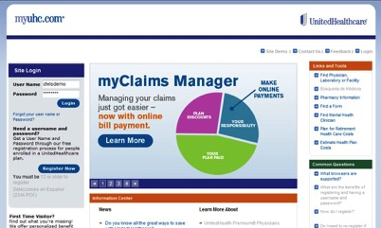
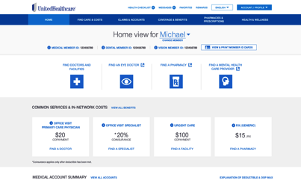
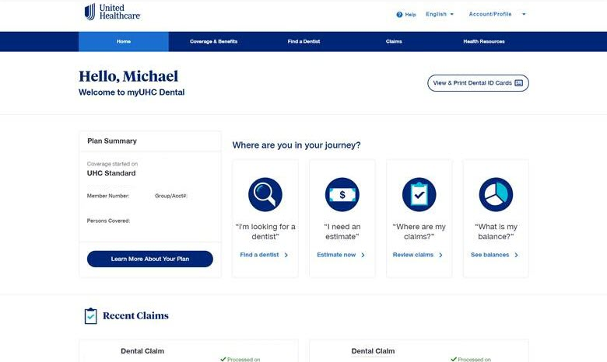
Providing access to benefits, tools and more at myuhc.com®
Dental | Dental Plans
Find a dentist
Get health and wellness information
Manage claims
Print their health plan ID card
Use the Cost Calculator
Notes:
Notes:
[Marketer: is there an updated look and improved usability on myuhc.com or is that old info? See first 2 bullets below.]
myuhc.com® helps make it convenient for employees to learn about and maximize their benefits.
Updated look and feel to create an experience that is simpler to navigate and understand
Improved usability of content and visuals by focusing on plain-language standards and clearly presented information and prioritized actions
Common navigation, look and feel across all digital assets (websites and apps)
With myuhc.com, employees can:
Find a dentist: Makes it easier to locate a network provider who’s nearby.
Get health and wellness information: Learn how oral health impacts overall health.
Manage claims: View claim history and pay a provider.
Look up benefits: See what’s covered by the plan.
Access and print their ID card: A convenient way too show proof of coverage.
Use the Cost Calculator: Find out what the plan will pay for a procedure and what the employee will have to pay. Compare local provider fees.

Slide 8



Your choice…
Dental | Dental Plans
Choose a network dentist
Each family member may choose their own
Show your ID card
Pay your copayment
Your claim will be submitted for you
Coordinated Care
Notes:
Notes:
Preventative services are no cost to you. Please refer to you plan summary for dental copay cost.

Slide 9
Points to remember…
Dental | Dental Plans
Board certified dentists
No deductible, no annual maximum and no waiting period
No claim form for covered services
Low predictable dental cost
Good oral health may be linked to reducing cost and complications of some high-risk, costly conditions such as diabetes, heart, and kidney disease
Individual needs addressed: With a whole person approach – Preventative and at-risk outreach
Network-only coverage
Coordinated Care
Notes:
Notes:

Slide 10

A focus on local, coordinated care
Dental | Dental Plans
Coordinated Care
www.whyuhc.com/sfhss
Notes:
Notes:
Note

Slide 11
Ready to enroll!
Dental | Dental Plans
Coordinated Care
1
2
Review your plan materials.
Go online:
visit www.whyuhc.com/sfhss
You must enroll during your initial eligibility or annual enrollment period.
Notes:
Notes:

Slide 12
Q & A

